Slide 1

Understanding the impact and what to do
TEAM 3: Ahmed Soltan, Taisa Maksymchuk, Nancy Gwany
August 21, 2019

Slide 2
“Employee Turnover Is The Highest It's Been In 10 Years” (Forbes 2018)
“For both the US and Canada, Generation Y (the millennial generation) is the most likely to voluntarily leave” (Mercer 2018)
“Employee turnover costs US companies $160 billion a year” (Wrike 2019)
“Employee turnover is one of the most important and challenging issues in human resource management” (HRM 2014)

Slide 3
“Employee Turnover Is The Highest It's Been In 10 Years” (Forbes 2018)
WE HAVE A PROBLEM!
“For both the US and Canada, Generation Y (the millennial generation) is the most likely to voluntarily leave” (Mercer 2018)
“Employee turnover costs US companies $160 billion a year” (Wrike 2019)
“Employee turnover is one of the most important and challenging issues in human resource management” (HRM 2014)

Slide 4
WHY SHOULD COMPANIES CARE?
Employee attrition/turnover is a prominent issue now more than ever!
It’s extremely costly from the:
Time and money spent hiring
Effort and distraction of training
Low productivity of new employees
Reduced product quality or customer service while new employees come up to speed
Off-the-shelf estimates are available, which might set the cost of an entry-level position turning over at 50% of salary; mid-level at 125% of salary; and senior executive over 200% of salary

Slide 5
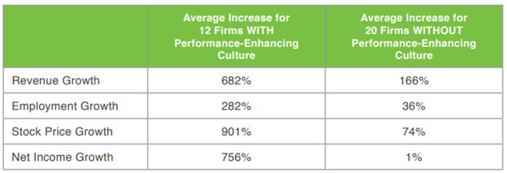
WHY SHOULD COMPANIES CARE?
John P. Kotter and James L. Heskitt conducted a research study for their book “Corporate Culture and Performance” which revealed these surprising statistics for firms reviewed over a period of 11 years:

Slide 6
WHY SHOULD COMPANIES CARE?
Simply put, companies that intentionally manage their cultures, including turnover rate, significantly outperform those that don’t

Slide 7
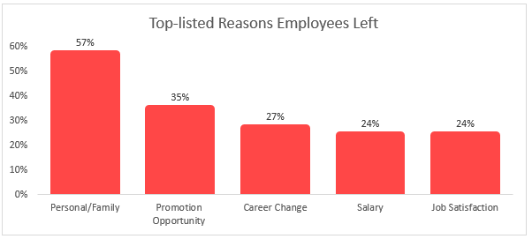
SO, HOW DO WE FIX THIS?
Employers can’t completely control turnover, at least not 100%. However, they can create a workplace culture that encourages the best employees to stay!

Slide 8
SO, HOW DO WE FIX THIS?
Data science can help organizations learn the reasons for employee turnover and take corrective action. Being able to predict what kind of employees are at risk of leaving will allow a company to proactively take retention actions
This project’s objective is to build a predictive model which can identify:
“The Who” - Profile of employees at risk of attrition
“The Why” - Features that contribute to attrition

Slide 9

DATA

Slide 10
Data Source & Attributes
This dataset contains data about 15,000 employees from an organization. Data was taken from Kaggle and it is a machine learning dataset.
Numerical:
Left = Binary value indicating whether an employee left or not
satisfaction_level = Score depicting employees satisfaction level of their job (0 to 1)
last_evaluation = Work evaluation score depicting employees performance (0 to 1)
number_project = Number of projects employee has worked on (2 to 7)
average_montly_hours = Number of hours employee worked monthly (96hrs to 310hrs)
time_spend_company = Length of time employee has been with the company (2 yrs to 10 yrs)
Work_accident = Binary value indicating if there was an accident
promotion_last_5years = Binary value indicating if promotion occured
Categorical:
sales = Department the employee is in (Accounting, HR, IT, R&D, etc.)
salary = Level of Salary (low, medium, high)

Slide 11
Data Source & Attributes
We enriched the data by adding additional derived attributes. In this regard, 6 calculated attributes were added to the data set as explained below:
Utility: Represents how the company has utilized a resource during her/his tenure. Higher the number of projects involved per year of service, higher would be utilization. This measure was calculated by dividing “Number of projects” by “Time Spent in Company”.
Throughput: “Throughput” represents how much output the resource has generated for the company. It essentially measures efficiency of the resource. This measure was calculated by dividing “Monthly Hours” by “Number of projects”.
Banded Categories for Continuous Variables
Utility Band
Throughput Band
Satisfaction Level Band
Last Evaluation Band
Notes:
Treating the variable as continuous allows you to estimate the linear component of the relationship, but the categorical version allows you to capture much more complicated relationships. Therefore some of the continuous / numerical variables were split into three categorical bands so that we can have a categorical variable as well to represent these variables.

Slide 12
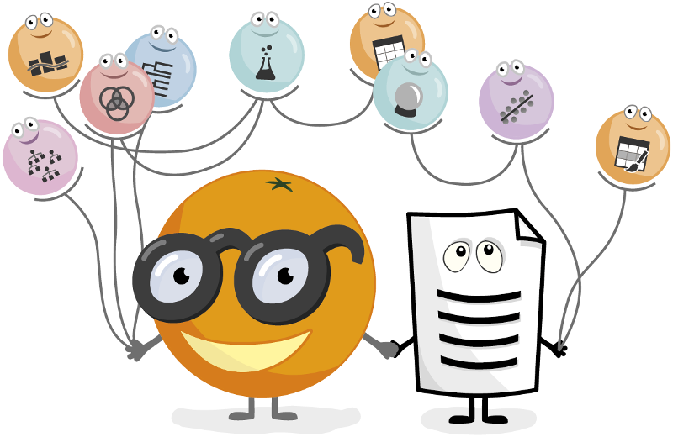
Exploratory Data Analysis

Slide 13
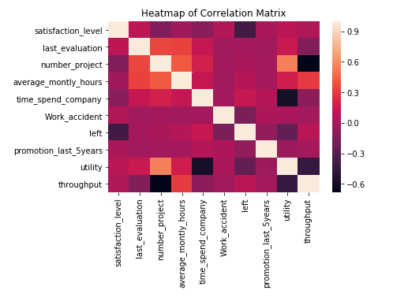
“Time_spend_company” and “Satisfaction_level” have the highest positive and negative correlation respectively

Slide 14
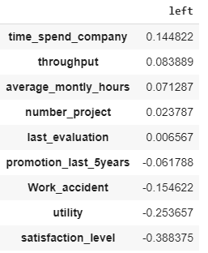
Intuition and business knowledge would also support such a relationship indicating that as employees experience in company increases, there is a natural tendency to leave and inverse in case of satisfaction level of employees.

Slide 15
GENERAL OBSERVATIONS: Descriptive Univariate Analysis

Slide 16
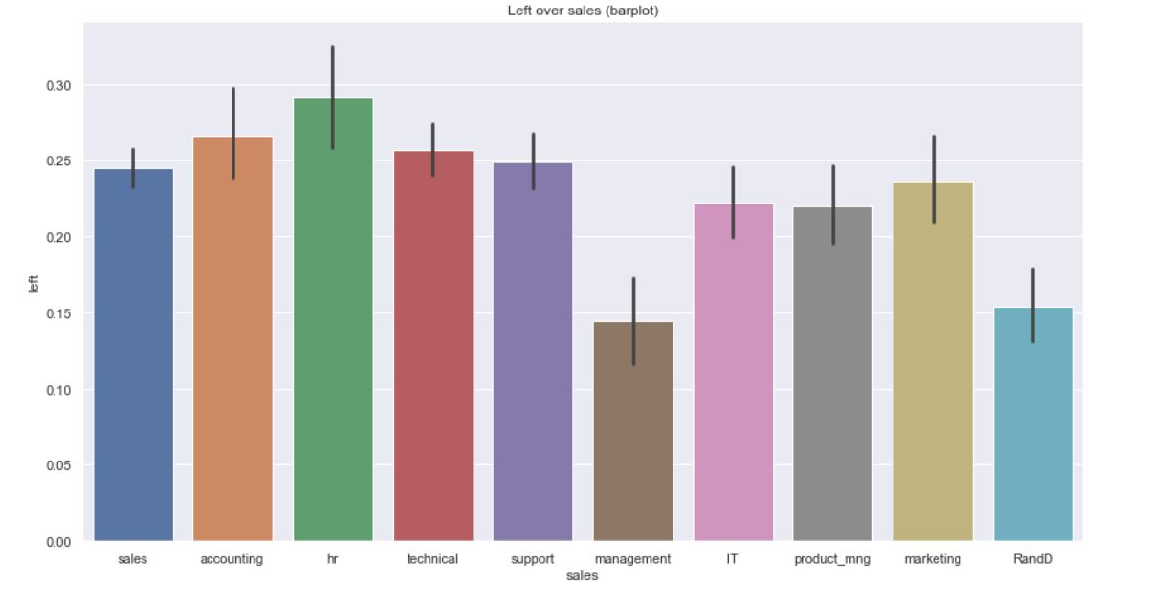
HR and Accounting have the highest turnover rate in contrast to Management and R&D which have much lower rates. Cross departmental learning can improve attrition rates of company on overall basis

Slide 17
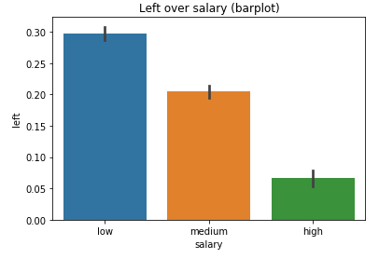
Intuitively, higher the salary; lower the attrition. Selective salary increases can be done for high risk, high performance employees

Slide 18
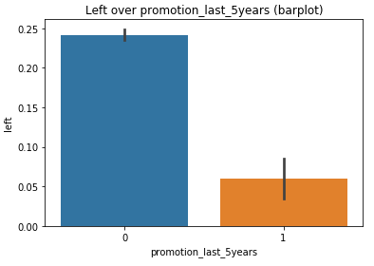
Similar to Salary, Promotion is inversely related to attrition. Company can use both these measures to retain the good talent and encourage the necessary “turnover”.

Slide 19
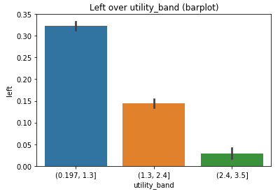
Lower the utilization(“Number of projects” / “Time Spent in Company”), higher the attrition. This shows that employees that have been under utilized were the ones that left the company

Slide 20
SATISFACTION LEVEL

Slide 21
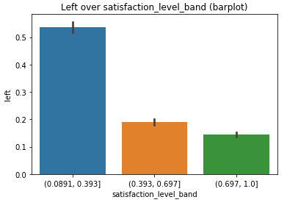
Lower satisfaction, higher attrition. This again is an intuitive finding. To increase employee satisfaction, a company can use different levers of influence (job enrichment, trainings, etc).

Slide 22
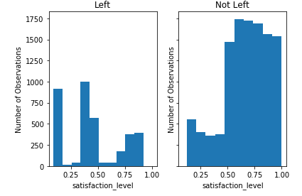
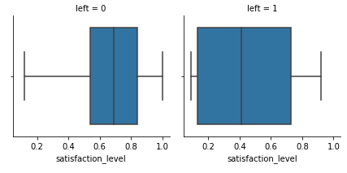
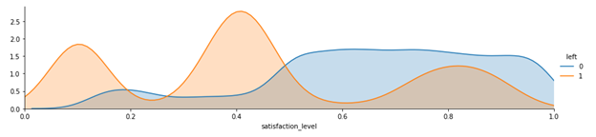
Employees that left had satisfaction level in range of 0 - 0.4
Based on the graph, we can also identify at risk employees that have not left with low satisfaction level

Slide 23
LAST EVALUATION

Slide 24
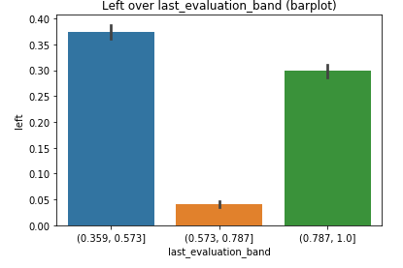
Low and High performers tend to be more prone to attrition when compared to medium performers.
Good Attrition - Company is losing low performers
Bad Attrition - Company is losing high performers

Slide 25
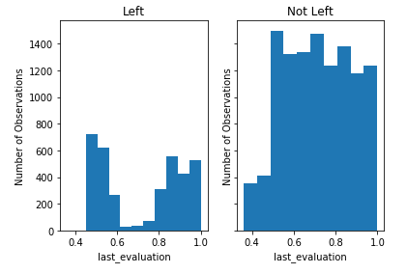
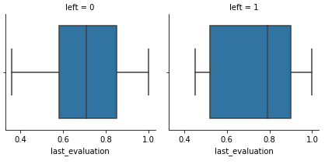
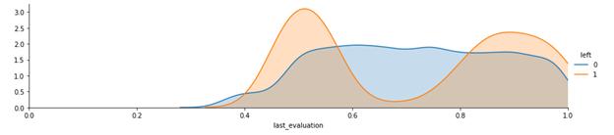

Slide 26
MODELLING

Slide 27
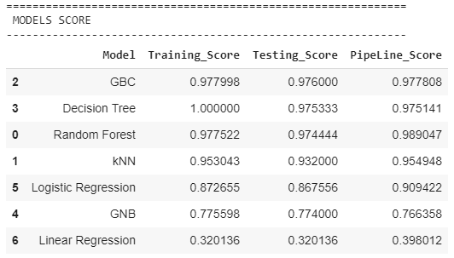
After completing our modelling we found that Random Forest to be the best model

Slide 28
CONCLUSIONS

Slide 29
Now that we’ve built Prediction Models to identify employees at risk, these should be used on recurring basis to identify highest attrition risk employees. Once these employees are identified…
a company must ensure they have a Retention Strategy

Slide 30



Build an Employee Retention Strategy
#1
#3
#2
Promotions
Promotion for those employees who are high performers and company would prefer to retain them at higher cost
Job Enrichment
Job enrichment by giving a challenging job and which will help build someone capabilities and skills.
Not Overworked
Balance workload for an employee by ensuring she/he is neither underworked nor over worked

Slide 31


Build an Employee Retention Strategy
#5
#4
Training
Training can be offered to employees to increase their job satisfaction
Salary
Salary rationalization for those employees who are good performers and company would like to retain them at higher cost

